Slide 1

Control Structures
Prof. Darrell Long
CSE 13S
Edsger W. Dijkstra

Slide 2
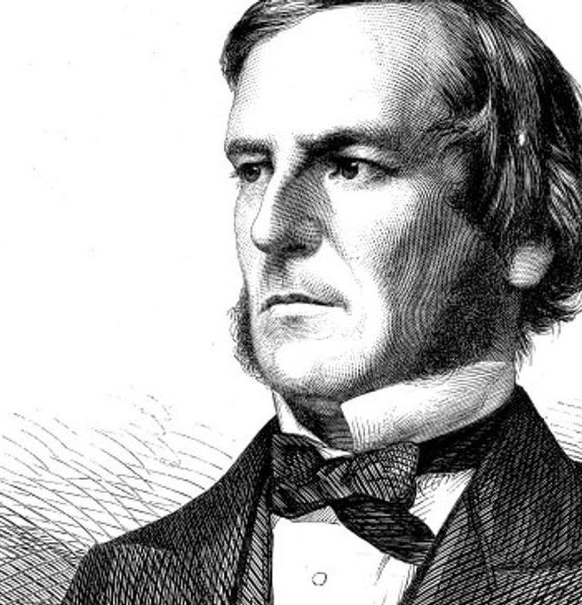

Boolean Algebra
Sought to set mathematics on a logical foundation.
Boolean logic has two values: true and false.
There are three basic operators:
∧ called and, also called conjunction (&& in C),
∨ called or, also called disjunction (|| in C), and
¬ called not, also called negation (! In C).
We will use true $=1$ and false $=0$.
George Boole

Slide 3

And (also called Conjunction)
Algebraic properties:
$A∧\left(B∧C\right)=\left(A∧B\right)∧C$
$A∧B=B∧A$
$A∧\left(B∨C\right)=\left(A∧B\right)∨(A∧C)$
$A∧1=A$
$A∧0=0$
$A∧A=A$
∧ (and) | T | F
T | T | F
F | F | F

Slide 4

Or (also called Inclusive-or or Disjunction)
Algebraic properties:
$A∨\left(B∨C\right)=\left(A∨B\right)∨C$
$A∨B=B∨A$
$A∨\left(B∧C\right)=\left(A∨B\right)∧(A∨C)$
$A∨0=A$
$A∨1=1$
$A∨A=A$
∨ (or) | T | F
T | T | T
F | T | F

Slide 5

Not (also called Negation)
Algebraic properties:
$A∧¬A=0$
$A∨¬A=1$
$¬\left(¬A\right)=A$
DeMorgan’s Law:
$¬\left(A∨B\right)=¬A∧¬B$
$¬\left(A∧B\right)=¬A∨¬B$
¬ (not)
T | F
F | T

Slide 6

Exclusive-or
$A⊕B=\left(A∨B\right)∧¬(A∧B)$
$A⊕B=\left(A∧¬B\right)∨(¬A∧B)$
Some algebraic properties:
$A⊕A =0$
$A⊕0=A$
$A⊕1=¬A$
$A⊕\left(B⊕C\right)=\left(A⊕B\right)⊕C$
⊕ (Xor) | T | F
T | F | T
F | T | F

Slide 7
Logical Operators
< | Less than
<= | Less than or equal
== | Equal
!= | Not equal
> | Greater than
>= | Greater than or equal

Slide 8
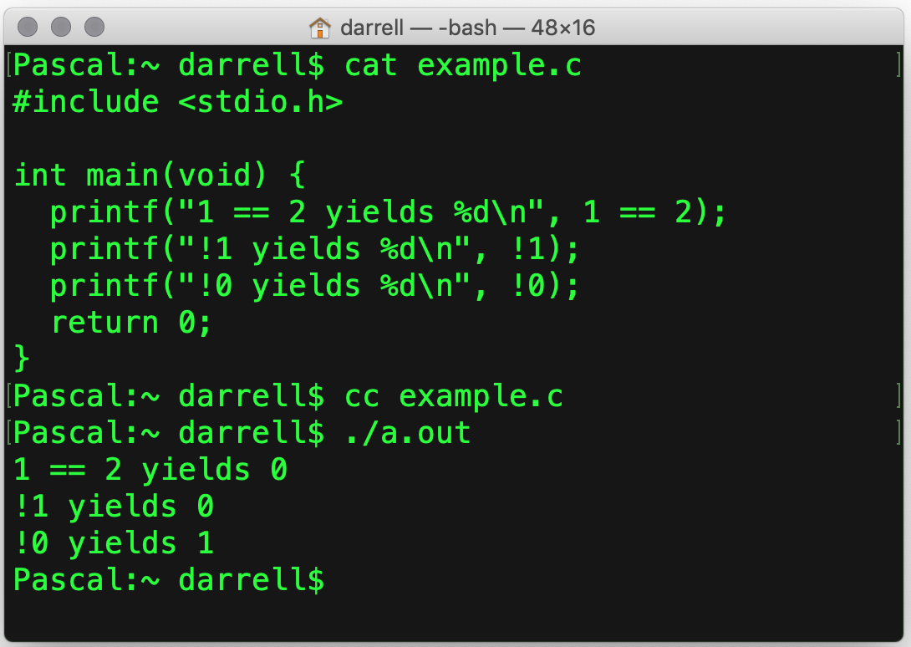
True and False in C
In C, zero (0) is false.
All that is not false is true.
Logical expressions have type int.
You can have true and false if you:
#include <stdbool.h>

Slide 9
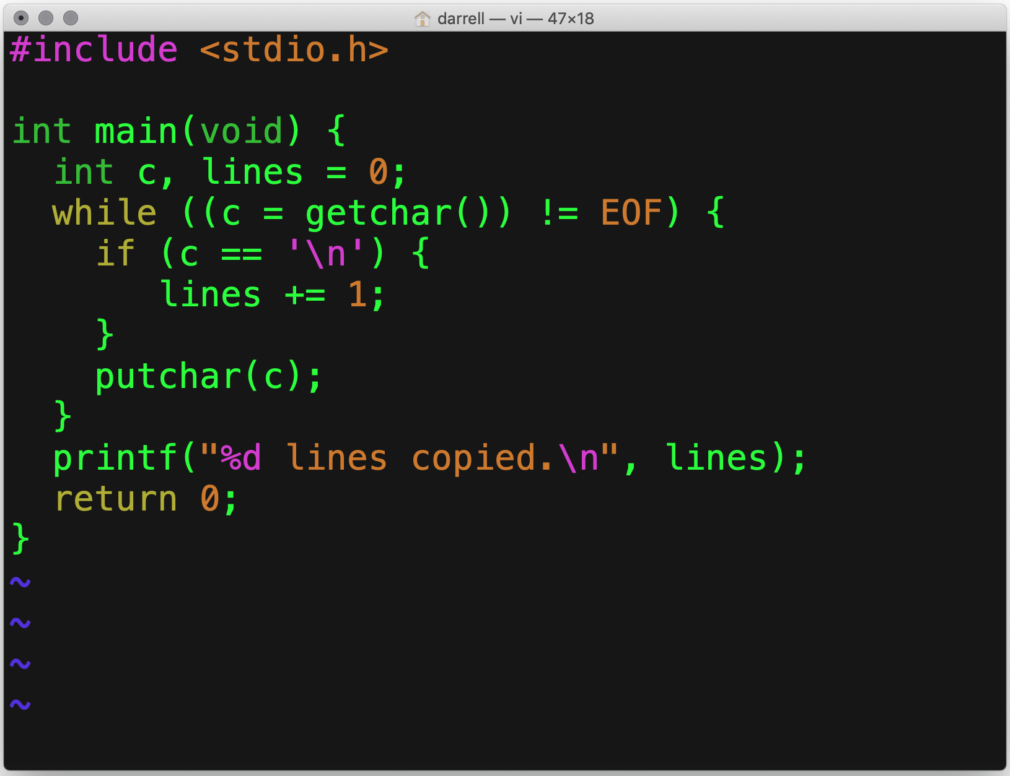
if ()
if executes the next statement if the Boolean expression is true.
Even through {} are not required for a single statement, always use them.
Why?
It avoids errors when adding statements.

Slide 10
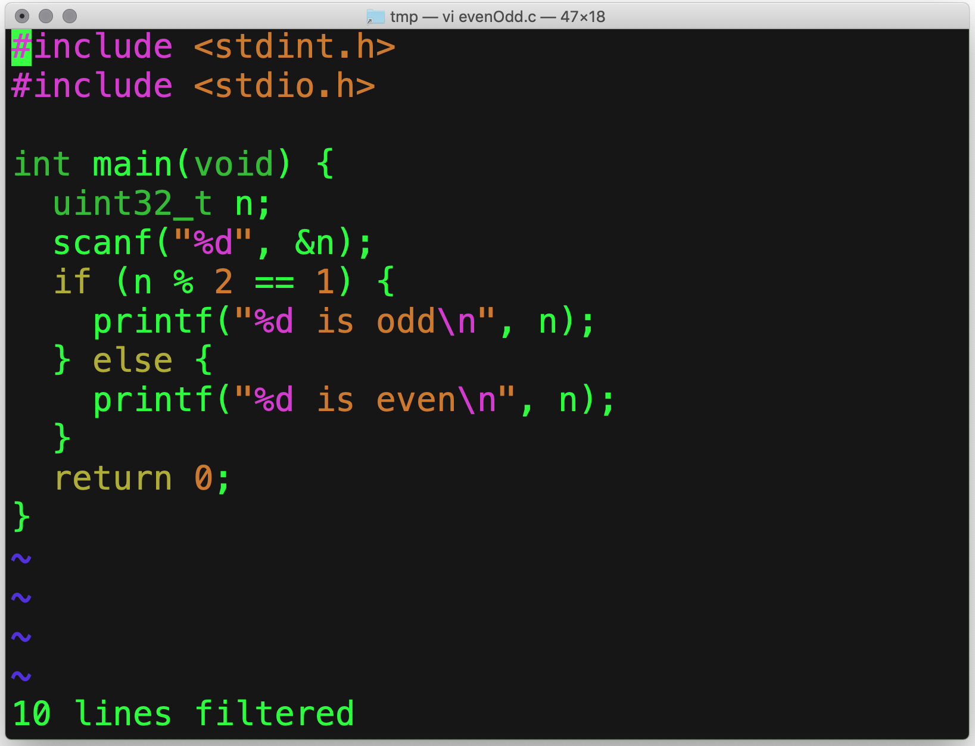
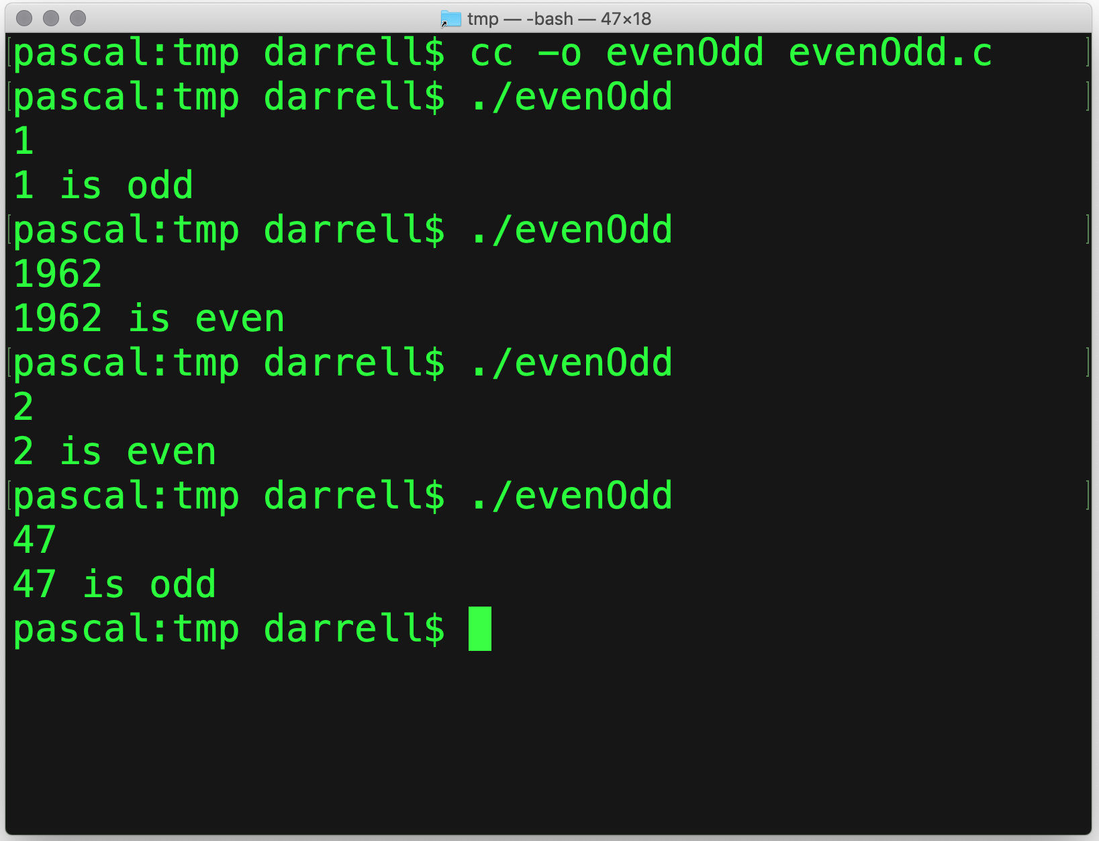
if () { … } else { … }
Read a number
True
False

Slide 11
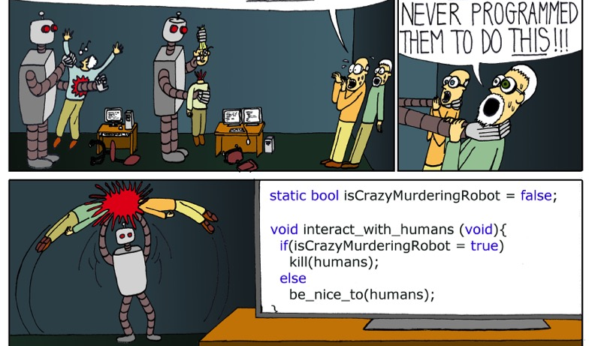

= $≠$ ==
(x = 17) is always true.
What?!?
Assignment (=)
is not the same as
Equality (==)
Oops!

Slide 12
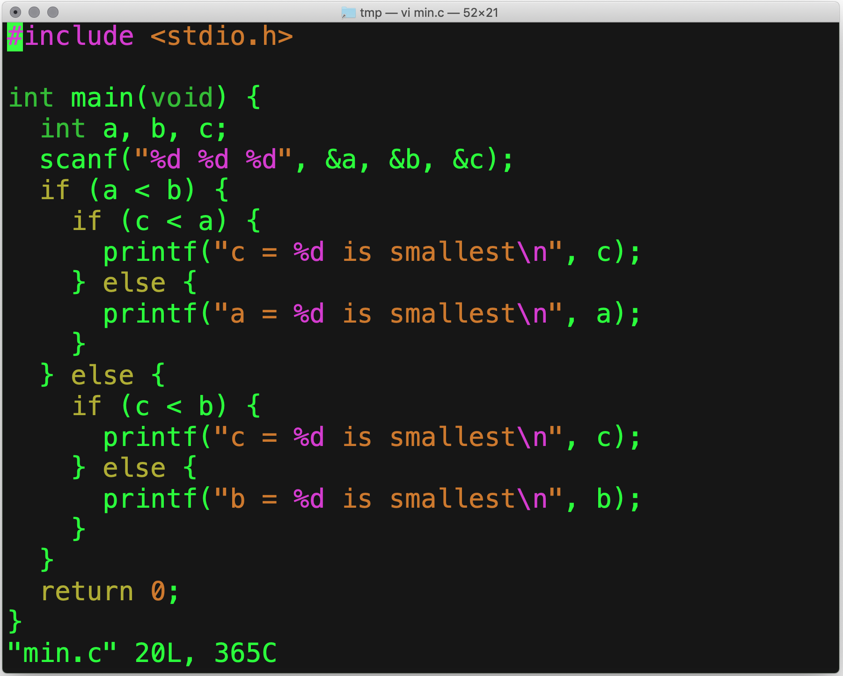
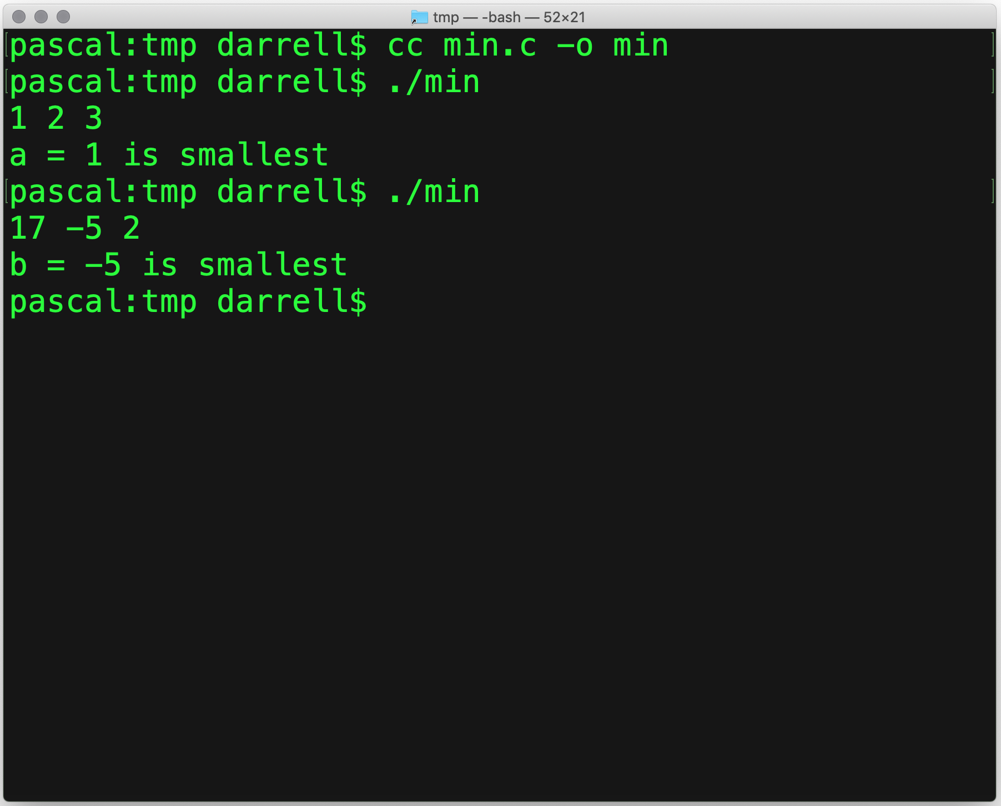
Nested if ()

Slide 13
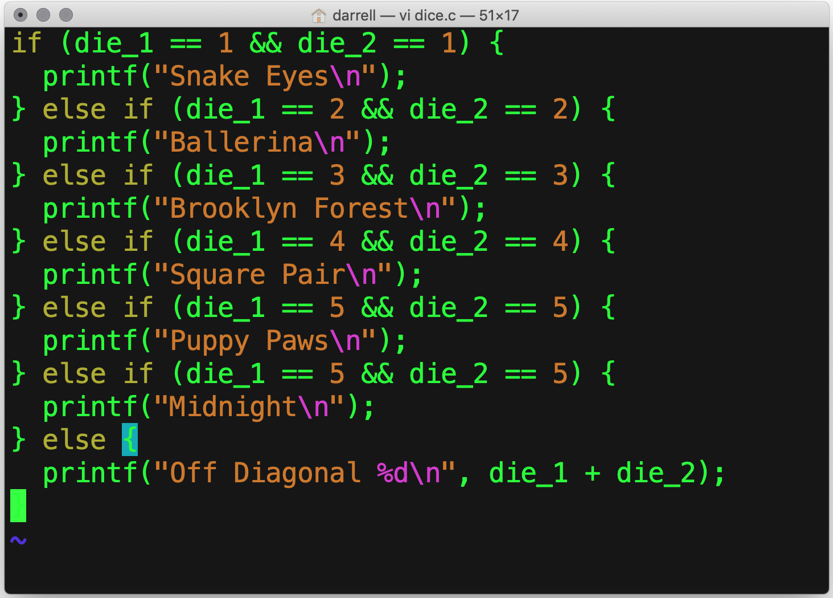
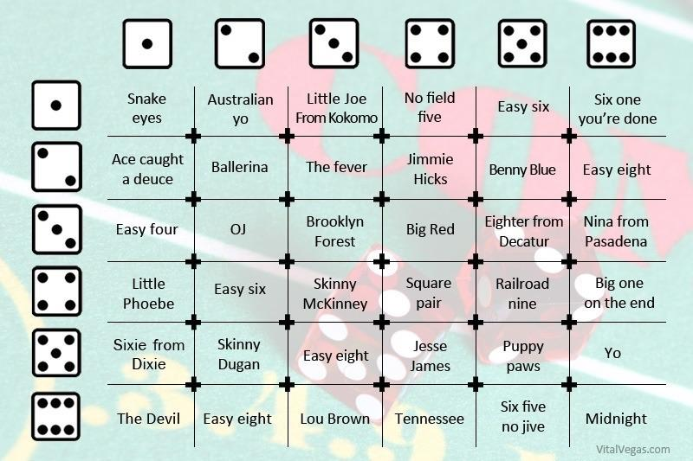
if () { … } else if () { … } … else { … }

Slide 14
Boolean Operators
&& | Boolean “and” (∧)
|| | Boolean “or” (∨)
! | Boolean “not” (¬)

Slide 15
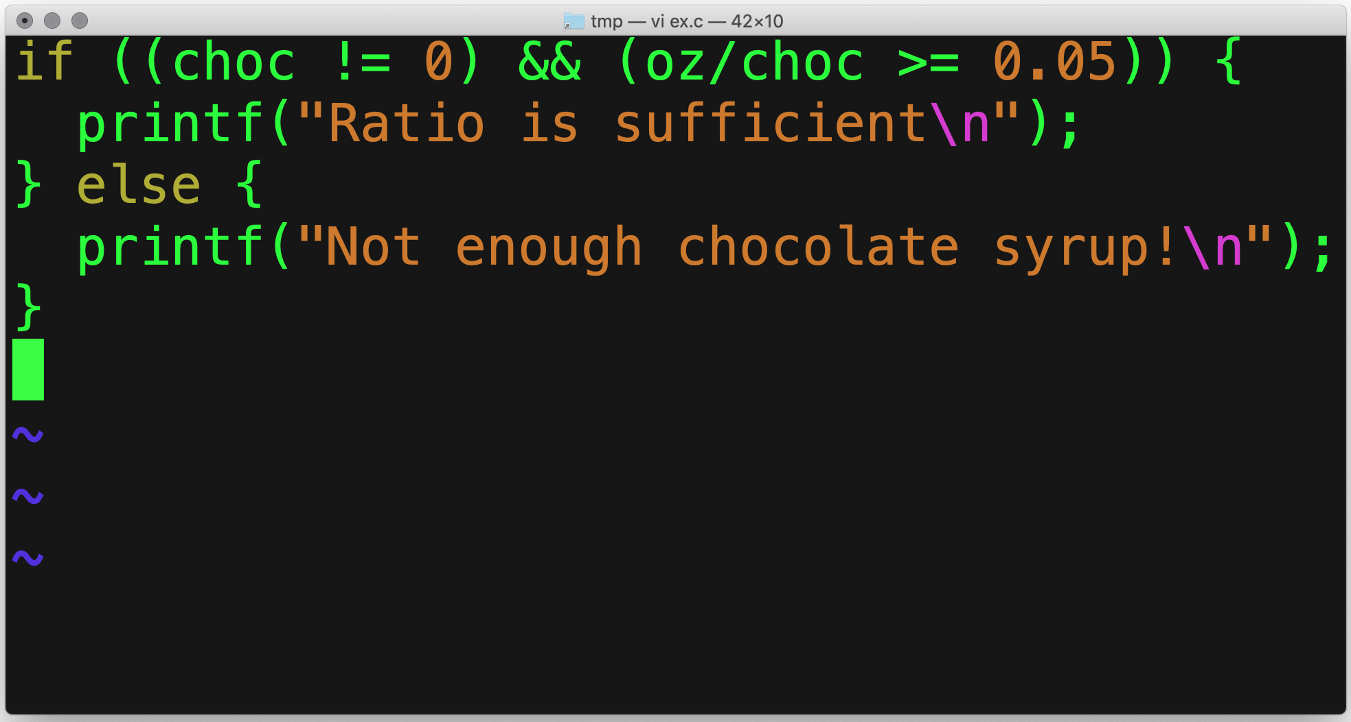
Short-circuit Evaluation
false && anything is false
true || anything is true
Stop evaluating as soon as we know the result.
Suppose we evaluated the entire expression:
We would be dividing by zero.
We could follow a null pointer.
More on that later.
Only do this if the denominator is not zero!

Slide 16
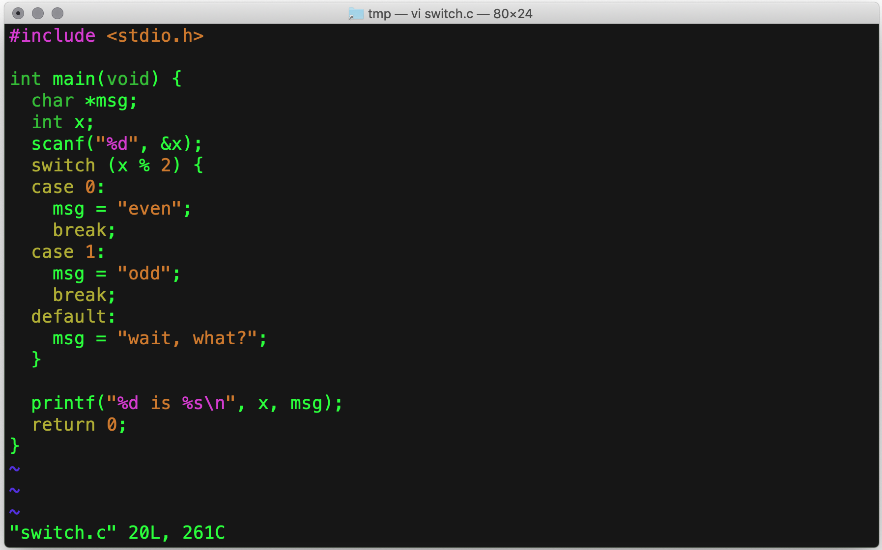
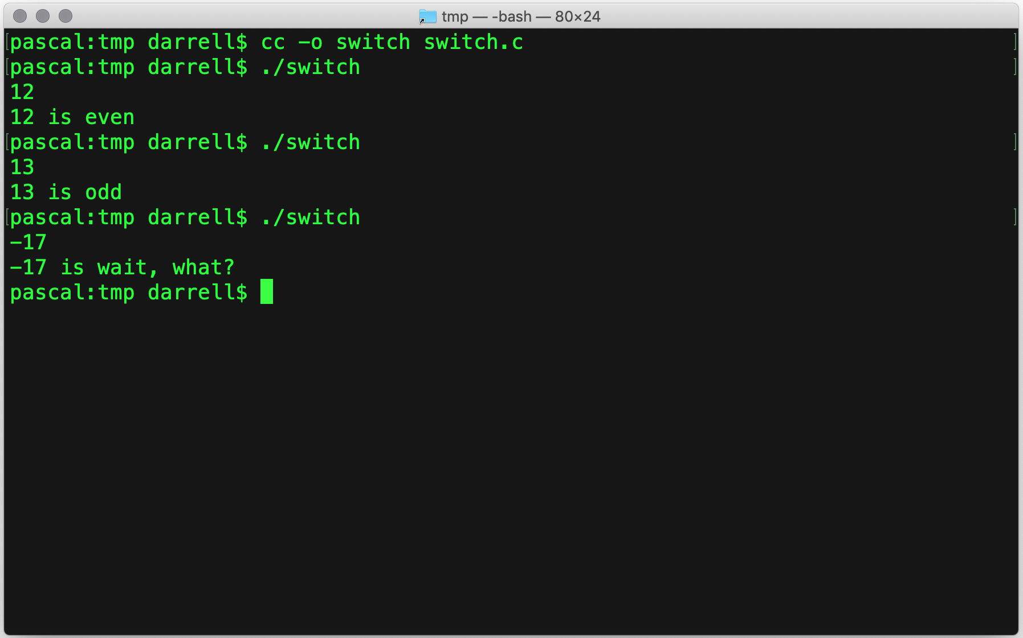
switch ()

Slide 17
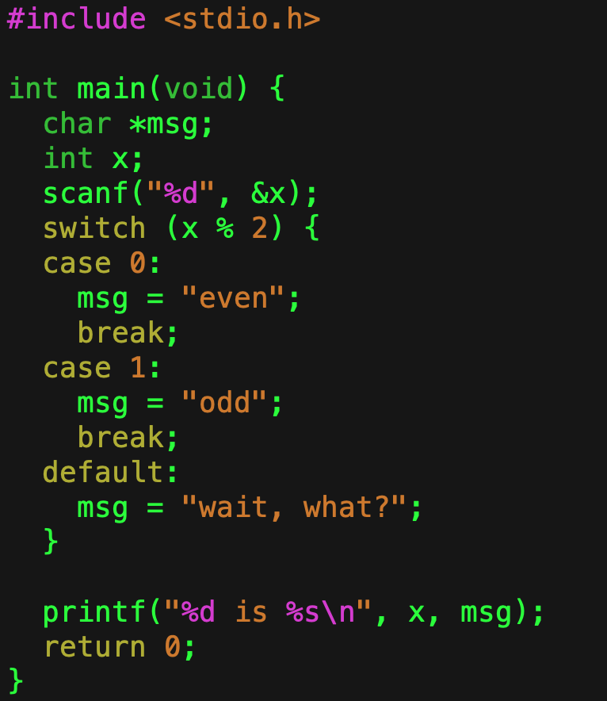
switch ()
If x % 2 == 0
Allows you to select among a fixed set of alternatives.
If none of them are present, then default is chosen.
Use break to skip to the end
If you forget, it will fall through to the next case.
If x % 2 == 1
Skip to the end

Slide 18
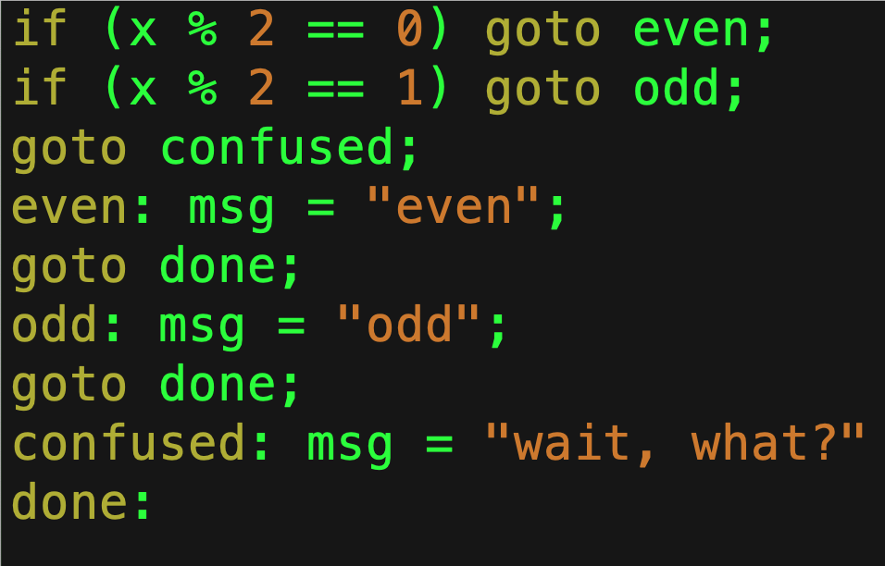
Equivalent goto Code
Like break

Slide 19
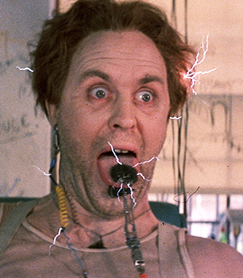
What is wrong with goto?
It is not so much not knowing where you’re going, but knowing how you got there.
You could, for example, goto the middle of:
An if statement,
A switch statement, or
A loop
It is not even clear what that would mean.
Dr. Emilio Lizardo
‘Cause remember: no matter where you go, there you are. —Buckaroo Banzai

Slide 20
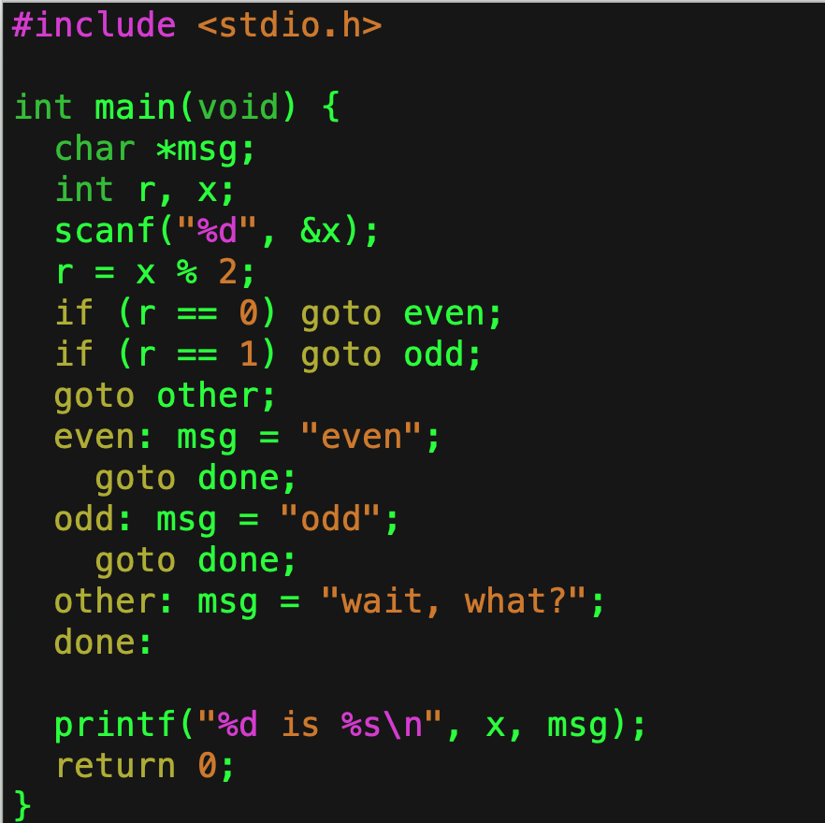
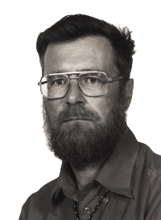
goto
If you use goto then you are a failure at programming!
This is an equivalent program.
Can you see the need for break?
This kind of programming is considered very bad form.

Slide 21
Summary
Boolean logic is a branch of mathematics dealing with just two values: true and false.
Since computers have just two values, 0 and 1, it is a perfect fit.
C uses 0 for false, and non-zero for true.
Short-circuit evaluation allows the expression to be determined as soon as possible.
if (expression) statement
Executes the statement if the is non-zero.
else statement
Executes if the statement was zero.
switch (value) selects cases correspond to the value.
goto jumps to a label.
Do not use it without a very good reason.

